Slide 1
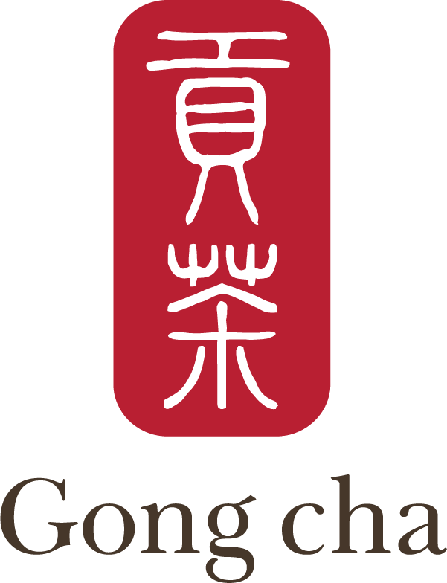
GONG CHA:
From entering Korea Market
to being a Big Success in S.Korea

Slide 2

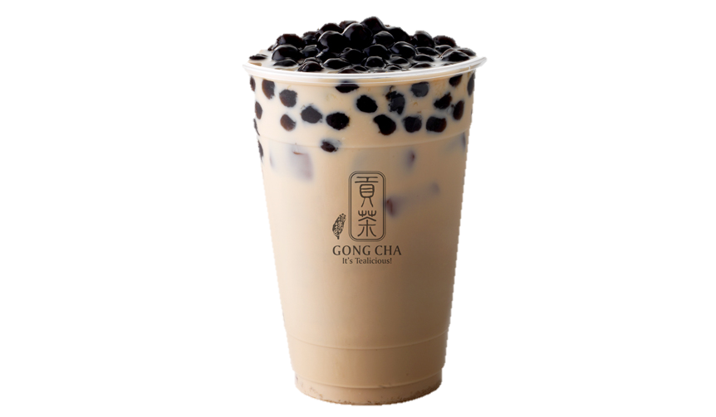
Briefing the COmPAny
Taiwan-style Drink Shop Franchise
Founded in 2006 in Kaohsiung, Taiwan(Royal Tea Taiwan)
Expanded to another Asia countries
(China, Singapore, S.korea)
The number of stores in main markets
Further expanded to America, Europe
Taiwan | China | Singapore | S.Korea
40+ | 600+ | 80+ | ?

Slide 3
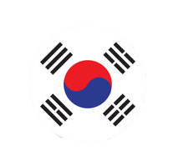
ENTERing The S.KOREA MARKET
2012 April, Gong Cha Korea was established
Royal Tea Taiwan licensed the brand to Gong Cha Koea
-------------------------------------------
It was started as startup company : managed by amateur boss, one Korean housewife
Lack of Store Management Control, Customer Manual, Computer System,
--------------------------------------------
Through the word of mouth, the brand became popular
Gong Cha chain stores increased quickly

Slide 4
After Entering the Market
Even the company consistently grow bigger, startup-like management has limits
--------------------------------------------
2014 July, global private equity firm, Unison Capital acquired Gong Cha Korea
Stated to managed by professional executive
He changed whole system and upgraded the management ability
--------------------------------------------
It become the leadar of S.korea bubble tea maket

Slide 5

BASIC STRATEGY
Selling Product Beverage Based on Tea
Main Selling Product Bubble Tea, Milk Foam, Creative Mix Same as Global Stores
(yogurt, juice)
Price Point Over 100 NTD High Price Point
Bubble Tea Price 113 NTD Starbucks Americano 121 NTD
Type of Stores Cafeteria, Take-Out Mainly Focusing on Cafeteria
Number of Stores 380+ The Leader of Market

Slide 6
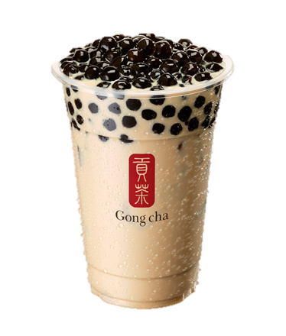
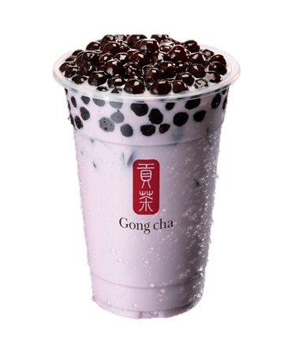
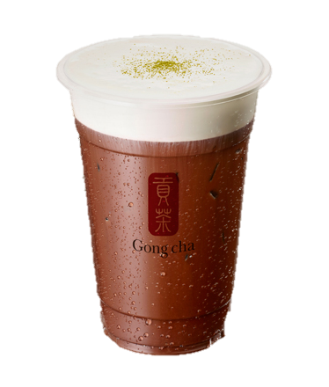
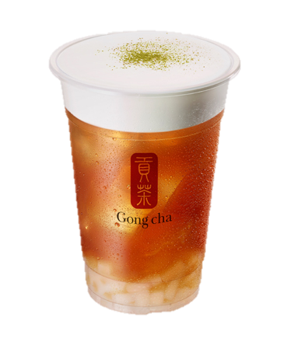
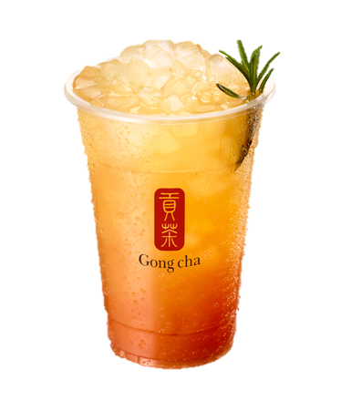
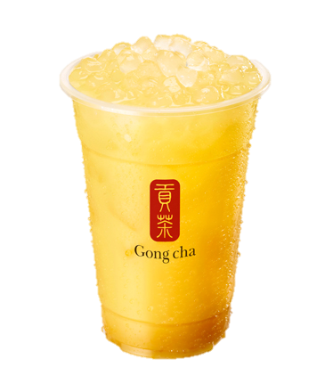
Basic strategy
Bubble Tea Milk Foam Creative Mix
Milk Tea + Bubble Pure Tea + Milk Foam Pure Tea + Fruit, Yogurt
113NTD+ 108NTD+ 116NTD+

Slide 7
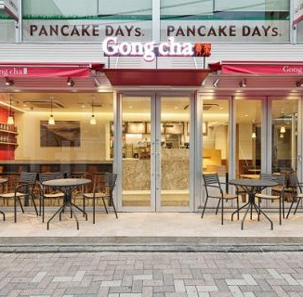
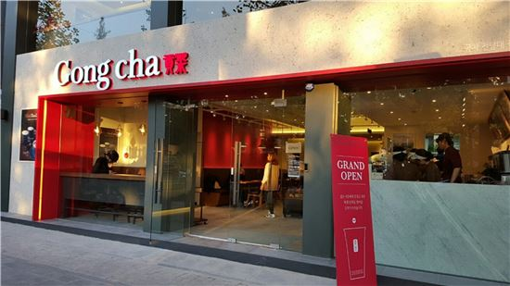
BASIC STRategy

Slide 8
PRICE STRATEGY
Taiwan Market
Has been existed for 30 years
and very popular
Considered as the beverage
that can be enjoyed by
everyone
Intense competition between
many brands
S.korea Market
Entered the market in 2000s
and failed in the beginning
Considered as the new
kinds of beverage and
fascinated Koreans
Many brands started to enter
No leader brand
There was opportunity for pricing the product highly

Slide 9
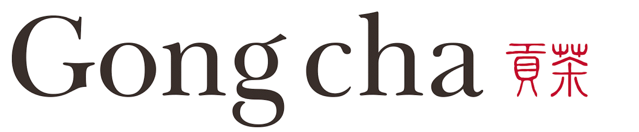




PRICE STRATEGY
No.1 113NTD
No.2 85NTD

Slide 10
PREmium tea : Product
Always use tea leaves for brewing teas
Instead of tea bags or powder
#1
Always strived to offer the
best tea to customer
Always rebrew the tea every 4 hours
#2
Customers will willing to pay more for having a better tea
#3
Do not add preservatives and artificial colors

Slide 11
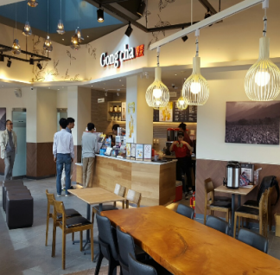
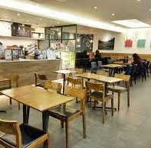
Premium TEA : place
Expectation for the Price
: Product Itself + Service
It provides the place where customers can do their activies(reading books, chat, study)
Customers will willing to pay more for their services

Slide 12


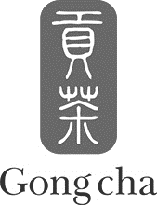
PREmium tea : Promotion
‘Barista’
‘Tea Master’
Marketed as the tea is brewed by ‘Tea Master’
Gives customers more professional image about the company
Used male actor for delivering the image

Slide 13
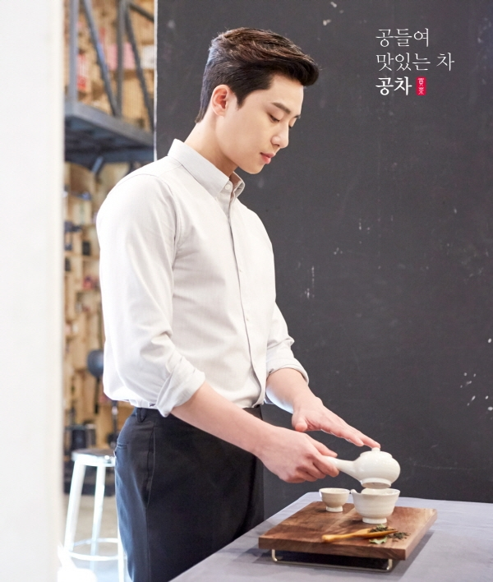
PREmium tea : Promotion

Slide 14
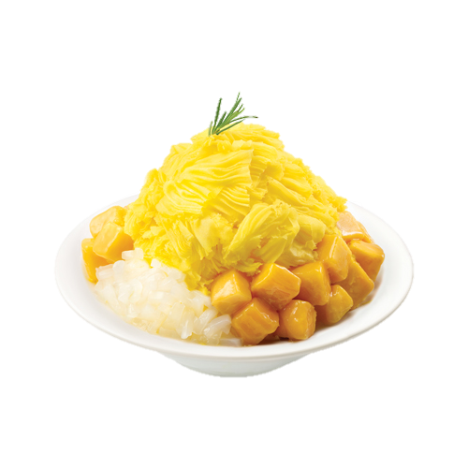
DevelopinG PRoduct Strategy
?
Creating New Seasonal Drink
From the beginning, it only sold the same product with
Gong Cha Taiwan
Creating New Dessert

Slide 15
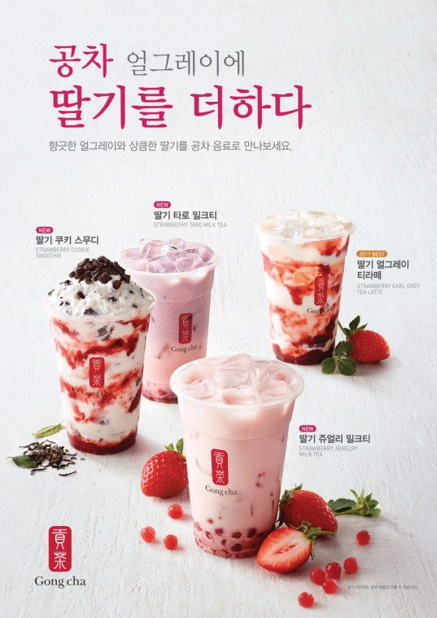
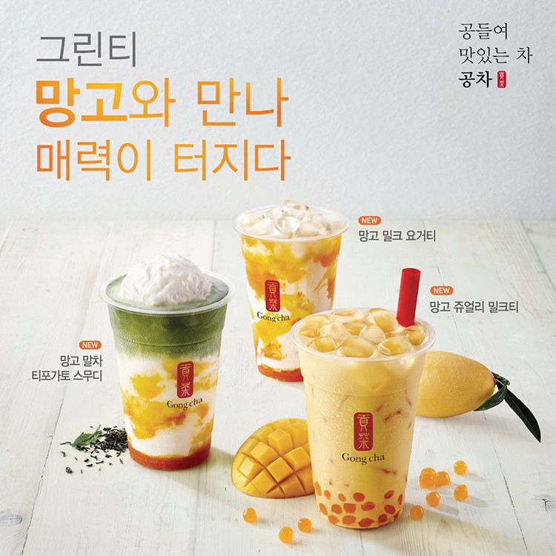
DevelopinG PRoduct Strategy
2017 :
Seasonal
Strawberry
Drink
2018 :
Seasonal
Mango
Drink

Slide 16
DevelopinG PRoduct Strategy
Fresh Fruit Juice became popular
: ex) ‘JUICY’ has 800+ store in S.korea
Gong Cha Korea developed some new tea drinks based on fruits
It is introduced as Seasonal Drink
only sold for one year or one season

Slide 17
DevelopinG PRoduct Strategy
#1
It gives new chance to customers who don’t like Gong Cha drinks
#2
It gives chance to make new customers who even haven’t tried it
#3
It gives chance to make original customers come more often

Slide 18
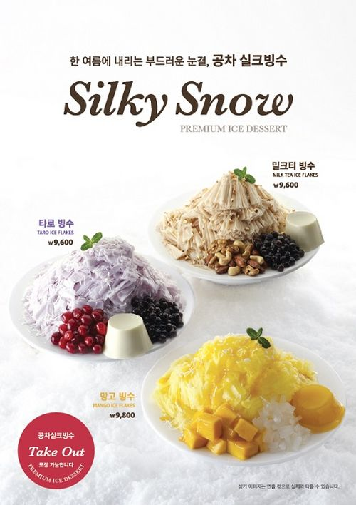
DevelopinG PRoduct Strategy
S.Korea Dessert Culture
: Many people enjoy ice flakes in summer
Gong Cha introduced Taiwanese ice flakes which is famous for Korean traveler
Half of the sale for the summer comes from these desserts

Slide 19

Product
Price
-Beverage based on Tea came from Taiwan Gong Cha
-Seasonal drinks based on certain fruits every year
-Seasonal dessert based on Korean’s culture
-Because it is seasonal, doesn’t need to be worry about increasing menu
-New produTake up a lot of percent of sales
-Entered the market as expensive beverage
-Sold more expensive than other competitors
-Justified with Premium Tea Marketing
-Earned more money in S.korea market compared to other global markets
Place
Promotion
-Many of the stores are cafeteria type
-For the convenience, also introduced take-out type store
-Incheon airport Store
-Flagship store in Hongdae
-Convenient Store
-can sell more expensive and introduce new desserts
-let more Korean customers and foreigner know
-Introduced tea expert : ‘Tea Master’
-Used male actor for promoting the brand
-Promoted through tv commercial and SNS
-Public transportation advertisement
-give opportunity to let more people know about the brand
-recognized as premium brand

Slide 20



Conclusion : Huge success
EBIDTA
Acquirement
Good Example how the company should do when they need to pioneer the market
20%
22%
Good Example how the company need to success in
Korea beverage market
Became the company leading the beverage market
For the more control of the brand, they acquired headquarter
Thank You for listening!

Slide 21

‘Barista’
‘Tea Master’
Marketed as the tea is brewed by ‘Tea Master’
Gives customers more professional image about the company
Used male movie star for delivering the image

Slide 23
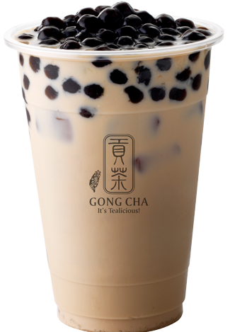
Taiwan-style Drink Shop Franchise
Founded in 2006 in Kaohsiung, Taiwan
Expanded to another Asia countries
(China, Singapore, S.korea)
The number of stores in main markets
Further expanded to America, Europe
Taiwan | China | Singapore | S.Korea
40+ | 600+ | 80+ | ?
*For some reasons, all of the Singapore stores are rebranded as

Slide 24
From entering Korea Market
to being a Big Success in S.Korea
HA SEONGJIN

Slide 25
Briefing
The
Company

Slide 26
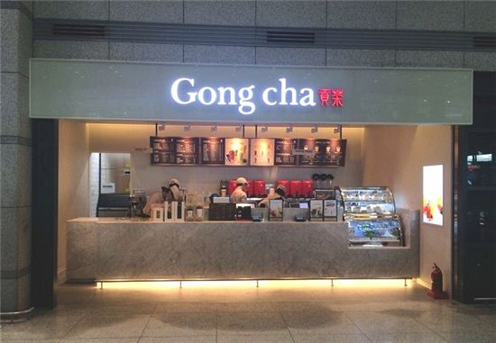
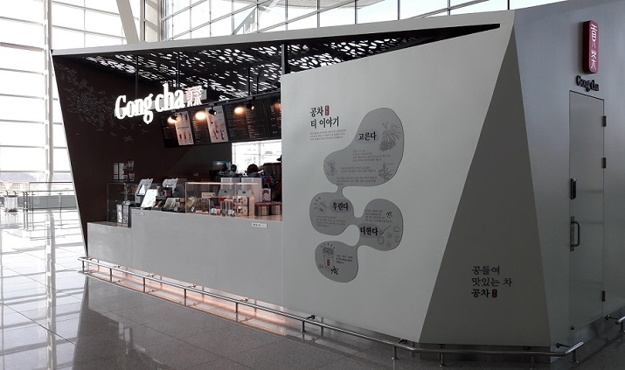
BASIC STRategy

Slide 27
How They Entered
S.Korea Market

Slide 28

It is different from Other Global Company…..
One Korean Housewife get interested in GongCha
After 1 year of persuation, Gongcha sold their Rights for S.Korea to Her
She opened Firt Store in HongDae
Originally, She even didn’t think of opening new branches(stores)

Slide 29
S.Korea
Beverage
Market

Slide 30
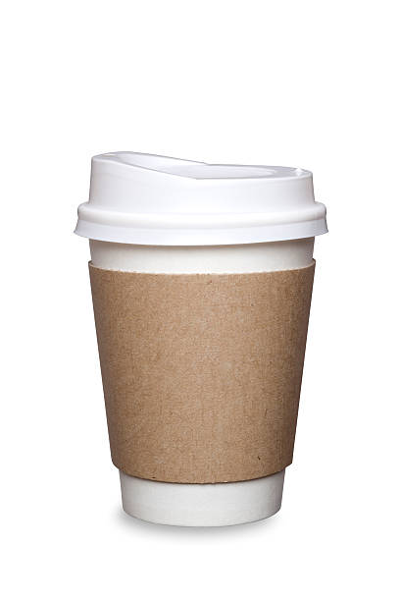
X10
Korean beverage market is mainly concentrated on Coffee
Coffee Market has a current value of US$8400million
In Calculation, Each Person Drinks 512 Cups of Coffee
In 10 years, Market Increased 10 Times

Slide 31

Korean People started to Find Another Beverage
Even coffee market is still increasing,
people started to get bored of coffee
Traditional Coffee Store Strategy
Started to introduce new kinds of beverage,
But It didn’t satisfied the market

Slide 32

Good chance for Bubble Tea to Enter the Market
Various Bubble Tea Brands Entered the Market
It is Good Chance
for Bubble Tea to enter
the Market

Slide 33
Gongcha was one of the Fastest Growing Company
Even their bubble tea price is the most expensive,
there are 400+ Gong Cha stores in S.korea
S.korea became one of the biggest market for Gong Cha,
even larger than Taiwan

Slide 34
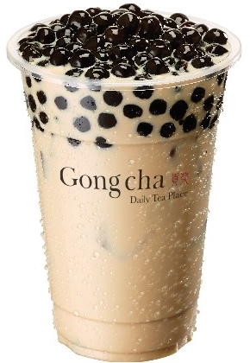
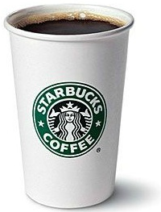
Price Localization
Gongcha was one of the Fastest Growing Company
Even their bubble tea price is the most expensive,
there are 400+ Gong Cha stores in S.korea
S.korea became the second biggest market for Gong Cha,
even larger than Taiwan

Slide 35
What is Different from Others?

Slide 36
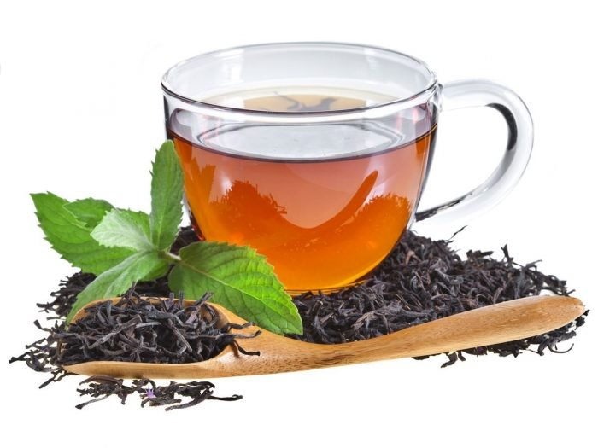
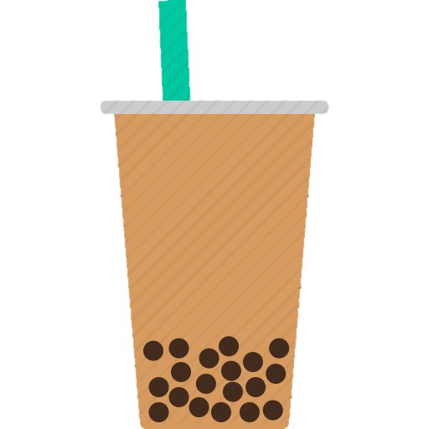
They More Focused on ‘PureTea’
rather than ‘Bubble Tea’

Slide 37
PURE
TEA
Good for Health
Enjoying Slowly
Needs brewing
Origin of tea leaf is important
Derived from Nature
It is regarded as Healthy Drink
It is Not Enjoyed by Everyone

Slide 38
Bubble Tea
Delicious
High in Calories
Make you fat
Sweetness
Artificially made
It is Enjoyed by Everyone
It is regarded as Unhealthy Drink

Slide 39
Pure Tea
Bubble Tea
Even they sell Bubble Tea,
But their marketing is focused on PureTea

Slide 40
How They Focused on Tea?

Slide 41
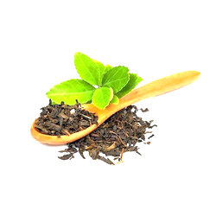

STANDARDIZE
To Make a Good Qualiy Tea
Always use tea leaves for brewing teas
Instead of tea bags or powder
To Keep the Quality of Tea
Always rebrew the tea every 4 hours

Slide 42


LOCALIZE
To Make Enjoy the Tea Slowly
Operated as café instead of take-out store
To Make a Pure Tea
Do not add preservatives and artificial colors

Slide 43

Example
https://www.youtube.com/watch?v=NVSR-GirUJg

Slide 44
Local
Strategy

Slide 45
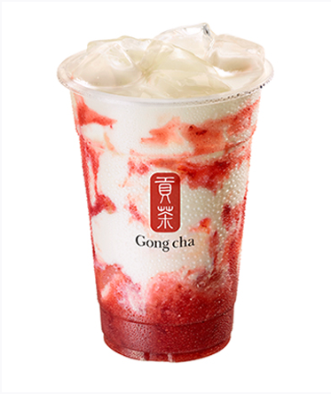
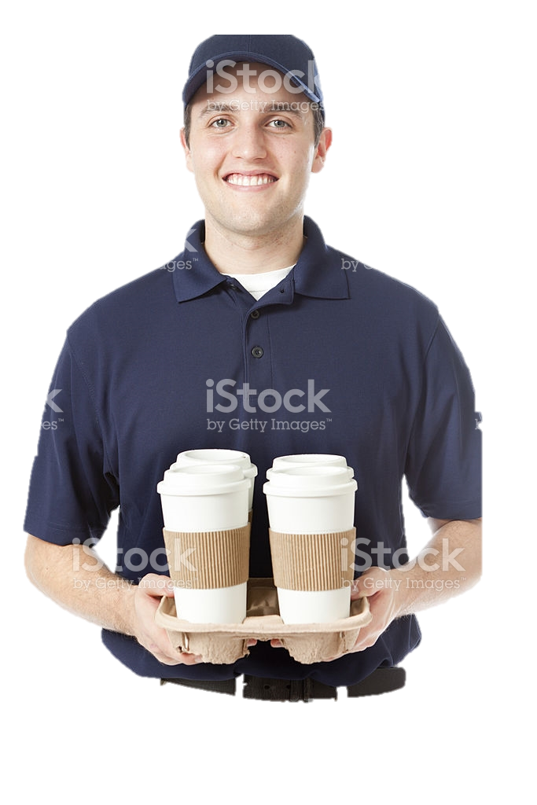
Introduce Seasonal Menus Every Year
2017: 4 Strawberry Drinks + Strawberry Pearl
2018: Mango drinks + ?
Introduce Delivery Service
Mainly focusing on Office Area

Slide 47
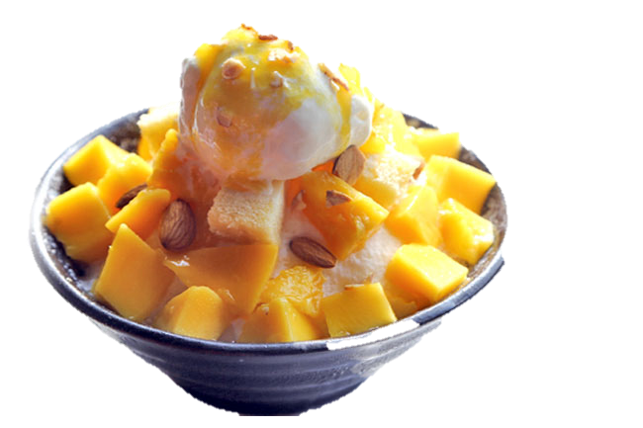

Introduced Different Type of Dessert
Introduced Taiwanese Mango Ice Flakes
Opened Airport Store
To promote Gong Cha to more foreigners

Slide 50
Conclusion

Slide 51
Operating Profit Rate is Very High
[Gong Cha Korea 22%] vs [Starbucks Global 20%]
Derived by premium image and their expensive price
Acquired Headquarters of Gong Cha
Started to control whole branches all over the world
But it is still a Taiwanese company

Slide 52
Thank You for Listening!!

Slide 53
How
They are successful?
What is
Different
from Others?

Slide 54
STANDAR
DIZATION

